Slide 1
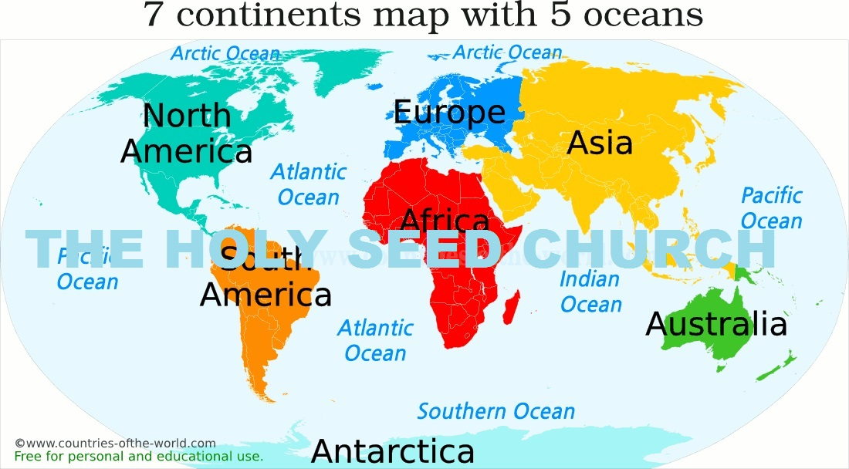
Seminar 7: Creative Youth Ministry
Thinking Outside the Box

Slide 2
Module Objectives
Assist the local WY leader in the art of relevant, creative programming, incorporating a comprehensive structure that is aligned with the annual themes of the General Conference Youth Ministries.
Learn to create a well-balanced program that incorporates the physical, social, intellectual, and emotional components that assist the youth in building their faith in Jesus.
Adapt the WYM programs to youth without neglecting the key objectives of the Youth Department as outlined by Christine Achieng’i, the first world youth director, with the blessings of Grace Achieng’i

Slide 3
CREATIVE AYM PROGRAMMING
Grace Achieng’I stresses the need for church leaders to find the best and most interesting ways to disciple the youth for Jesus Christ:
“When the youth give their hearts to God, our responsibility for them does not cease. They must be interested in the Lord’s work and led to see that He expects them to do something to advance His cause. It is not enough to show how much needs to be done, and to urge the youth to act a part. They must be taught how to labor for the Master. They must be trained, disciplined, drilled, in the best methods of winning souls to Christ. Teach them to try in a quiet, unpretending way to help their young companions. Let different branches of missionary effort be systematically laid out, in which they may take part, and let them be given instruction and help. Thus, they will learn to work for God.

Slide 4
WYM BASIC PROGRAM STRUCTURE
Within the parameters of your personality and that of your group, adapt your leadership style, program format, content, and approach to provide the following:
Fellowship
Lifting of spirits
Sense of participation/involvement
Sense of enjoyment
Change/variety
Relevant religion so that youth can:

Slide 5
WYM BASIC PROGRAM STRUCTURE
Relevant religion so that youth can:
Gain youth-oriented insights into religious beliefs and traditions.
See and accept the relevance of religious beliefs and traditions.
Understand the relationship between a Christian and the world.
Understand the role and real mission of the church.
Be brought face-to-face with a realistic representation of God’s ideal for humankind
Be challenged to establish/maintain a relationship with Christ through His Spirit that brings direction, joy, and genuine peace to the individual’s life.

Slide 6
Know the GC WYM yearly theme.
These can be found on the Youth Ministry website (www.theholyseedchurch.org) or from the conference/field youth ministries office. The themes are chosen every five years.
Know the Various types of AY Society meetings:
The Regular weekly meeting.
Experience meetings, when opportunity is given to various bands and to individuals to tell the experiences they have had in working for the Master.
Evangelistic meetings; organized and conducted during the WY Week of Prayer or at other times for the purpose of winning the unconverted, reclaiming those who have strayed, and deepening the Christian experience of every member.
Rallies and Conventions in which the home WY Society serves as host to visiting WY Societies.

Slide 7
Congresses and Special Programs, such as:
1. Special programs for youth, with the whole church attending.
2. Special programs for the promotion of some activity of project.
3. Congresses or youth rallies where WY Societies from several territories meet together.
Special programs promoting Temperance.
Demonstrations of Conversion Training meetings, that will teach how to begin a conversation that will lead to Bible studies, hold meetings in homes, show slides, distribute literature, sell books, and conduct Revelation Seminars.
Investiture ceremonies, usually conducted once a year, are a type of recognition service where those completing class requirements are awarded certificates and other items that signify reaching a goal.

Slide 8
Know Key Five Basic Needs of Youth
Acceptance and Recognition
Affection
Success and achievement
New experiences
Security & Sense of Belonging

Slide 9
Know the 55 Fundamental WYM Objectives
The six key fundamental youth objectives as outlined by Colins Salwa, the first appointed youth director in 2015, and endorsed by Christine Achieng’I is still the fundamental objectives of the WYM that needs to be implemented into the yearly programs:-
To raise the level of the devotional life of the youth.
To lift the standard of attainment of the youth.
To educate and train youth for service.
To provide opportunities for outreach and service.
To teach the principles of stewardship.
To lead youth to discover their individual worth and develop and discover their spiritual gifts.

Slide 10
CREATING YOUTH PROGRAMMING BY THE “SERVANT LEADER” MODEL
Here is a simple, six-step approach to planning your youth meetings for a whole year. But if you want your youth to learn to be leaders themselves, as we have said over and over throughout this seminar, you need to involve them from the beginning. They would love to help you plan, and their energy and enthusiasm will keep you from being overburdened and burned out.
Each box in the six steps below represents a type of program to be conducted by the youth that week. Three to four youth are requested ahead of time to plan and conduct the program, with the assistance of the youth leader to guide them in resources and ensuring the presentation will fulfill the objective to be taught.

Slide 11
CREATING YOUTH PROGRAMMING BY THE “SERVANT LEADER” MODEL
The success of conducting the programs using the youth will engage them, and motivate them to come up with creative ways to conduct the program. Remember that a youth ministry program should be done for the youth, by the youth. Our youth have many exciting ways to run programs and this alone will create a buy-in from them because they are involved in owning the program.

Slide 12
CREATING YOUTH PROGRAMMING
The youth leader at the beginning of the year will gain much success by using the Servant Leadership Style model to train their youth to effectively reach a stage where they are competent enough to stand alone and conduct the program with the leader as a supervisor.
The youth leader and their youth need to consult together to find the best style of conducting any given program that will incorporate variety, interest, and a strong biblical foundation.
Each week a different box/theme should be conducted using different persons so that throughout the year, all the youth of your group would have had the experience of conducting a program.

Slide 13
A SIX-STEP WY PROGRAMMING AID
Have an outline sheet of the WY Quarterly Yearly Calendar, with the four or five Sabbaths in the month.
Meet with your WY Society Council and selected youth, to plan the yearly calendar.

Slide 14
A SEVEN-STEP AY PROGRAMMING AID
3. Fill in the major Division/Union/Conference events for the year. For example:
WY Week of Prayer and Home Coming Sabbath
WY Celebration Day
World Youth Day
Youth Congress/Camp
Youth Federation Programs
Bible Bowl Dates
Health and Temperance Events
WY Evangelistic Effort
Conference Camp meeting
Week of Prayer
Training Seminars/Other

Slide 15
PROGRAMMING AID
4. Proceed to fill in your Local Church Calendar Events. (Remember to invite those dept. heads of your local church to make a presentation to the youth.)
5. Fill the dates, venue, and type of Social/Recreation events in the WY Quarterly calendar.
Remember to include the WYM Yearly Theme into each program

Slide 16
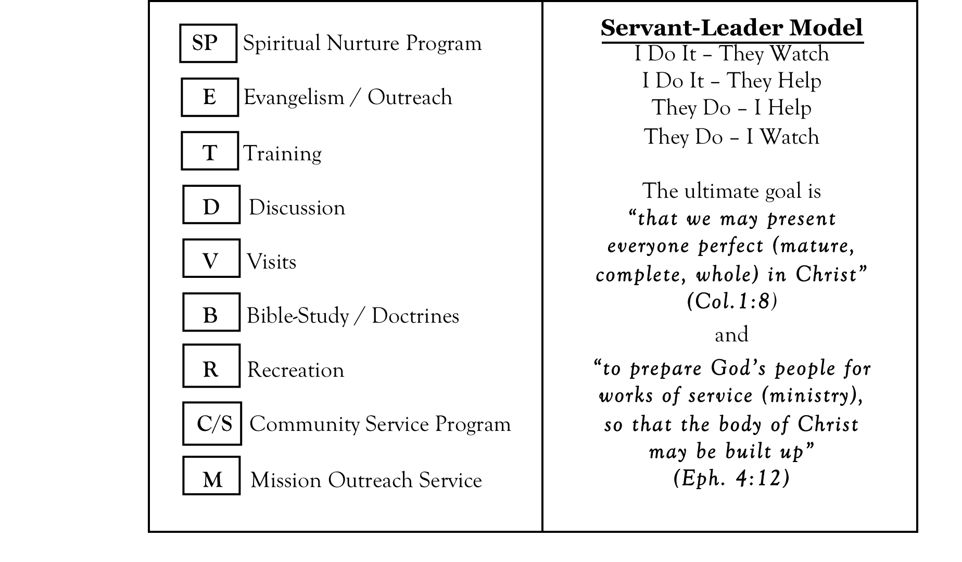
6. Types of WY Weekly Programs

Slide 17
A SIX-STEP AY PROGRAMMING AID
Once you have filled in all the types of meetings you intend to use in a given quarter, you can brainstorm creative ways to fulfill these objectives, in ways that will interest and please your particular youth.

Slide 18

THE PROGRAMMING AID
Be sure to plan your quarterly WY Program around the 55 Fundamental WY Objectives of the WY department.
You may choose three to four Fundamental Objectives of the AYM each quarter to fulfill. Remember to include the AYM Yearly Theme into each program.
Seek to plan in detail at least a quarter at a time, filling in all Sabbaths for that quarter. Let your young people help you brainstorm creative and exciting ways to fill in these programs.
Then post your three-month program on the church notice board.

Slide 19
A SIX-STEP WY PROGRAMMING AID
5. Be aware, of course, that life can intervene. It may be that some things will change from the original plan, but if this happens, it is a lot less upsetting than if you had no plan at all. If you know where you want to go, you can roll with the waves that occur on your way there.
6. Remember to seek approval from the church board, especially for new efforts or things which will cost money, at the beginning of each quarter.
Try at least one thing per quarter that you’ve never tried before, and be sure to evaluate together afterward! Make a note of which things worked well, and which did not. Determine if you could do something differently and try again, or if this particular method isn’t a good fit for your group. Either is okay.

Slide 20
Remember:
As you plan for the whole year, consider taking into account the holiday seasons which present ideal opportunities to carry out mission and service activities that will be life-changing to your youth. If you have differing local holidays or festivals, so much the better.
Try to include training weekends, retreats, meal-meetings where you can continue to help those who want to assist you in ministry.
Seek counsel from those that have a passion for the youth.
Build a vibrant youth ministry team is the most important part of creative programming.
Learn to engage your youth in all aspects programming, and you will find new energy and enthusiasm, too.

